Slide 1
CSEP Project – Voting Machine
An introduction to my project on Voting machine with an interesting GUI and Database Feature.

Slide 2
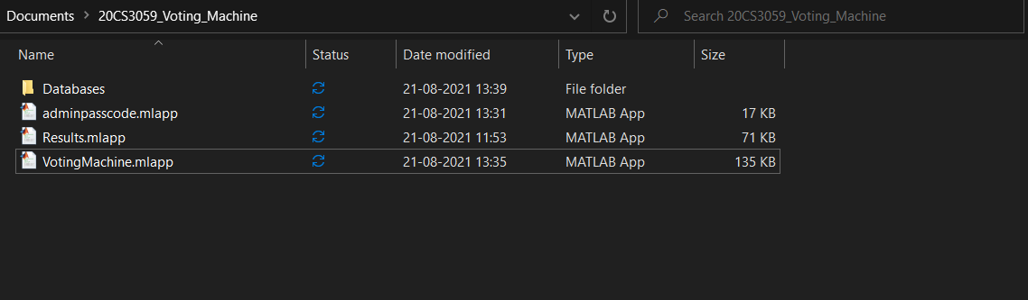
The main folder contains 3 MATLAB app files for the GUI and Processing and a folder named Databases to provide data for the app files. Only the VotingMachine.mlapp file has to be run since it’s the main file and gives arguments to others to display certain screens. The other two can’t run on their own due to lack of Arguments.

Slide 3
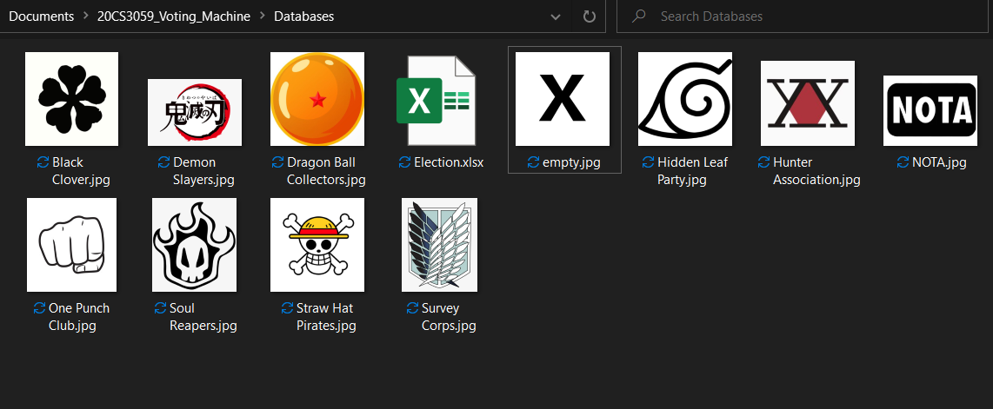
The Databases Folder contains an Excel file which will serve as a main database and some .jpg files for Party logos. These jpg files must have exactly the same name as the name of the party to which a candidate belongs.

Slide 4
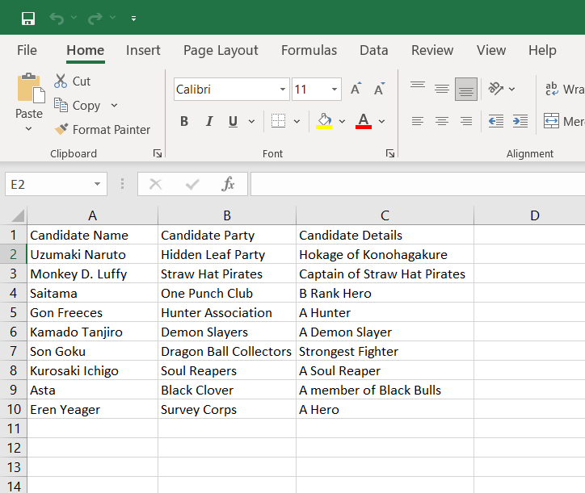
The excel file, named as Election.xlsx, contains data in the format as shown. Other candidate details can be added in next columns since it will not affect the functioning of the Voting Machine.
The app takes maximum 9 candidates and their party name which are to be entered from A2:B10 . Further discussion on case with more no. of candidates is in last slide.

Slide 5
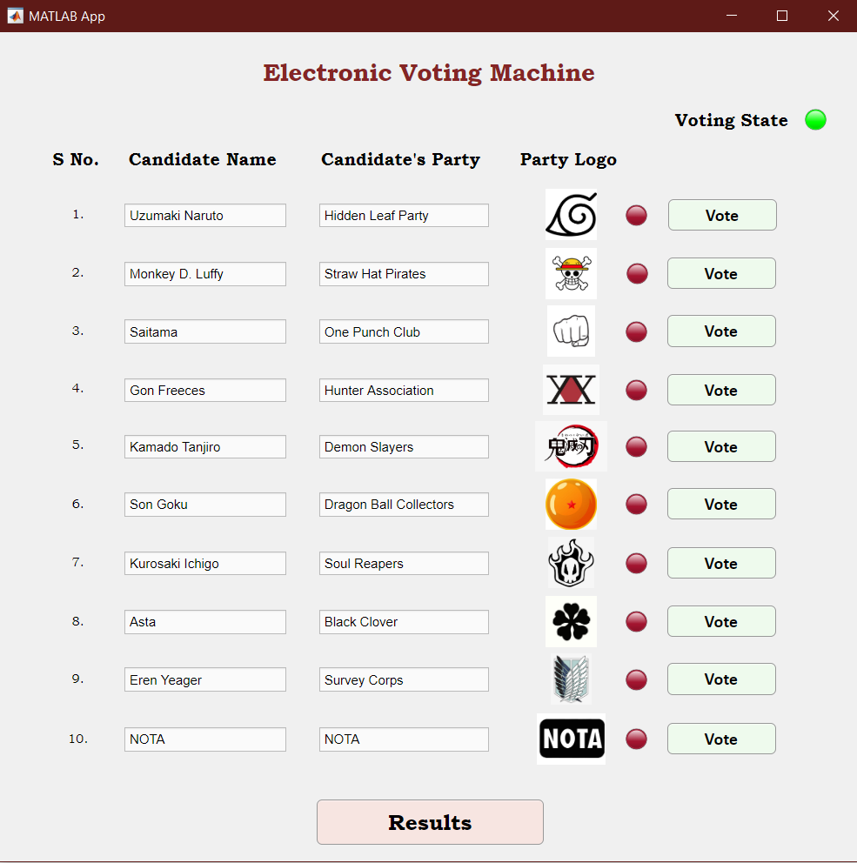
On opening the “VotingMachine.mlapp” file in the main folder, the GUI of the 1st screen of the app opens in the following format showing the following details and options –
Candidate names in non editable text boxes as read from the Election.xlsx file
Candidate’s party name in non editable text boxes as read from the Election.xlsx file
Party’s logo
A NOTA option by default.
Crimson(off) lamps in front of each candidate’s party logo for feedback to the user
Vote buttons in front of each candidate’s party logo which can be pressed (clicked) to cast vote to that candidate
A voting state lamp to show whether the user can vote at the current time or not
A results button to end the voting and view the results. (Can only be done by the administrator)

Slide 6
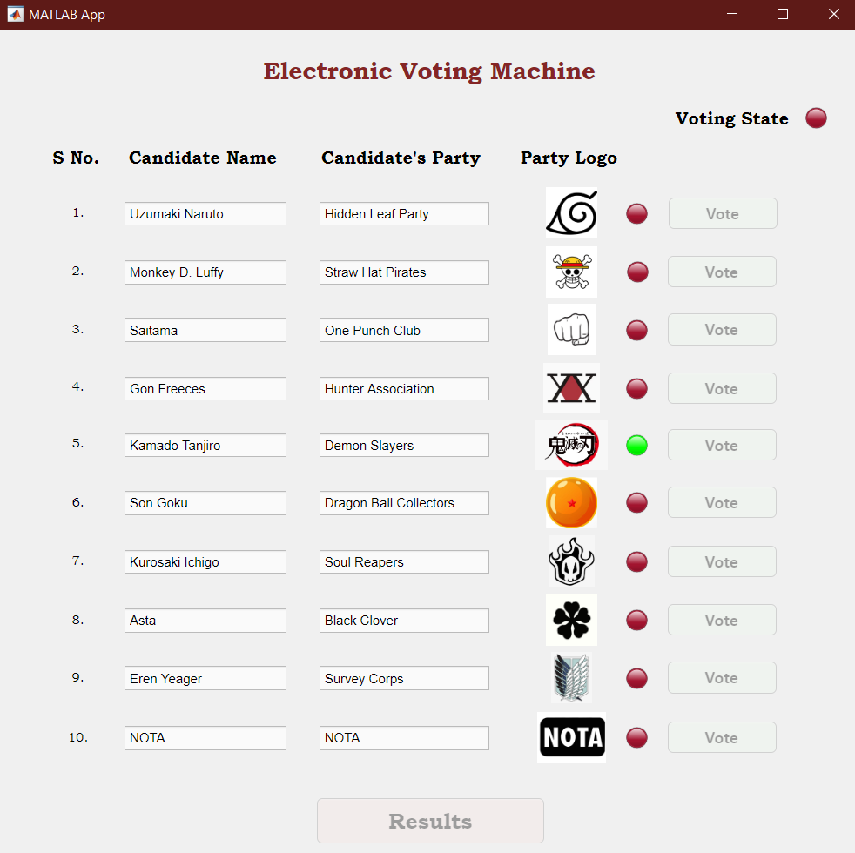
As soon as any of the vote buttons is pressed, the user hears a feedback sound and the lamp color of the candidate he voted turns green for one second to show the user who he has voted.
All the other buttons become disabled and the voting state of the app turns off.

Slide 7
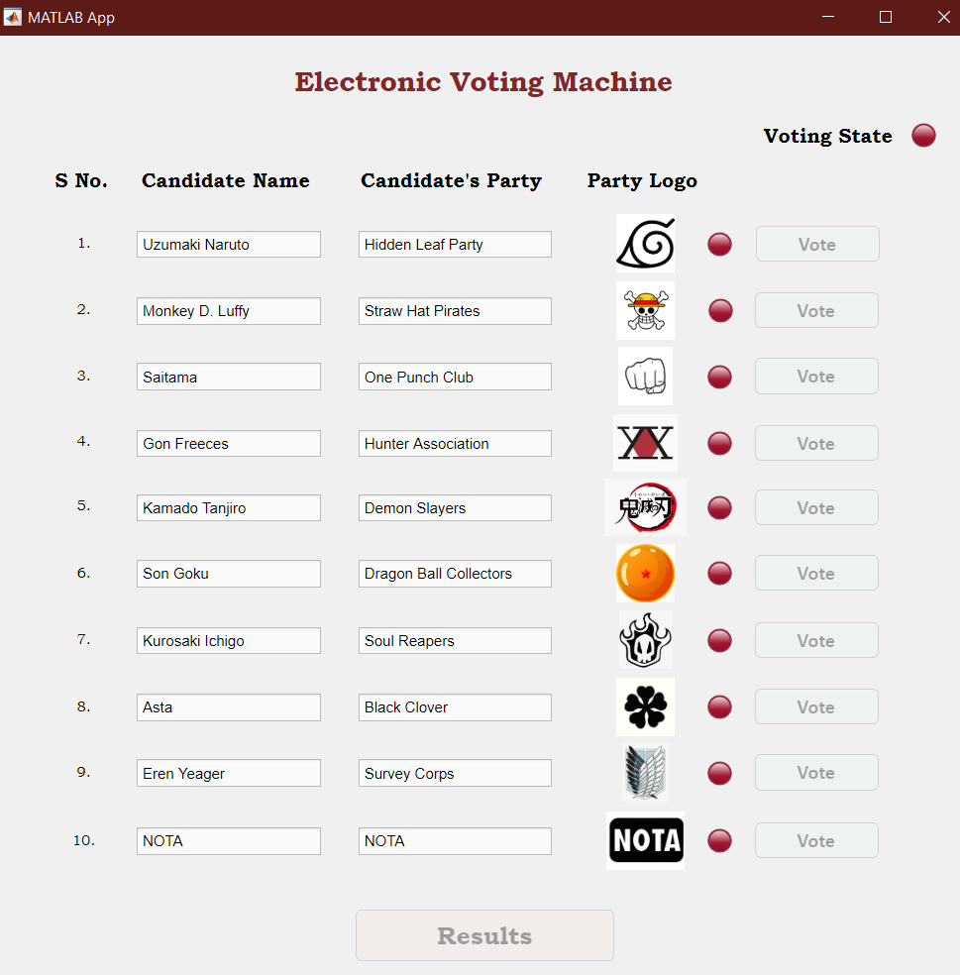
For the next 4 seconds, the buttons remain disabled and voting state lamp remains off and the last voter’s feedback also goes off to ensure the secrecy of his vote.
This steep has been taken to ensure that no voter can consecutively vote a single party many times.
During this total 5 seconds time, the voter can move out of the voting room and next voter can come to the machine and wait for his turn.
This wait is modifiable and depending upon the process, it can be stretched or shortened with a single value change in the code of the app.
After this, the app returns to its original state as in slide 5 so the next voter can cast his vote.

Slide 8
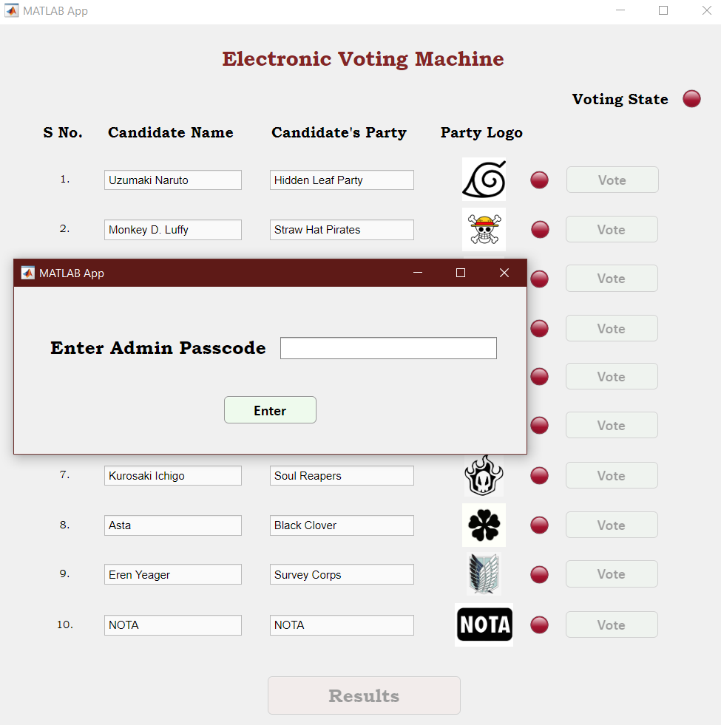
Upon completion of the voting round, the results button can be pressed and a screen appears asking for the Admin Passcode to ensure the safety of Votes and prevent results leak by a normal voter.
The admin has to enter the passcode in the Editable field provided and click the enter button to prove that he is the admin.
This screen is created by the “adminpasscode.mlapp” file from the main folder after being granted necessary arguments by the VotingMachine.mlapp’s GUI.
During this, every other button remains disabled and voting state off.

Slide 9
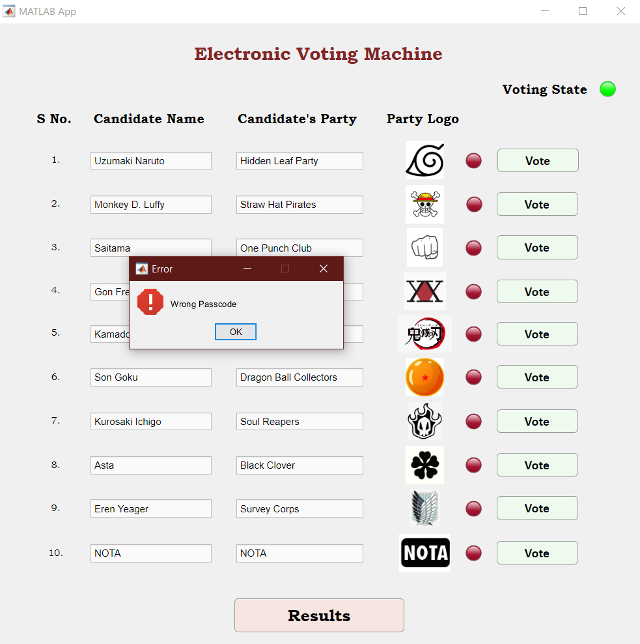
If the password entered is wrong, a message box showing the same error appears with a system beep sound.
All other components return to their original state as in slide 5.
In case the user closes the “Enter Admin passcode” window directly, all components return to their original state as in slide 5.

Slide 10
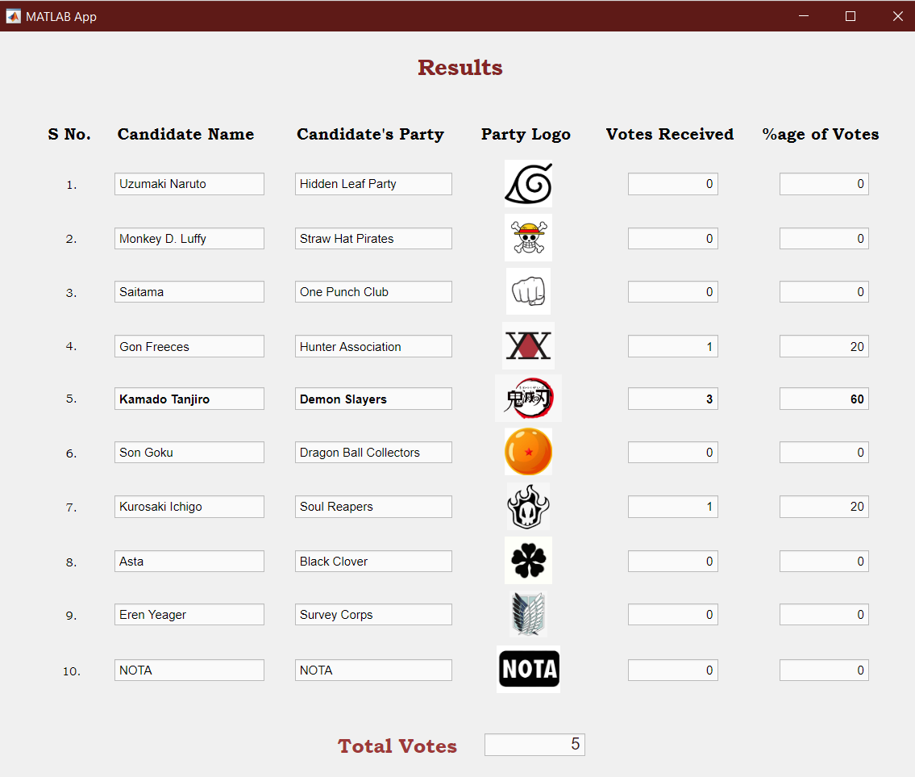
If the passcode entered is correct, both the previous windows close and the Final window – Results of the voting round appear.
This screen is created by the “Results. mlapp” file from the main folder after being granted necessary arguments by the VotingMachine.mlapp’s GUI.
This window contains –
Credentials of candidates and his party as in Voting window
Votes received by each candidate
Percentage of total votes gained by each candidate
Total votes casted in the election
Note that if a Candidate gains “more than 50%” of the total votes, his credentials become bold as he has won the election.

Slide 11
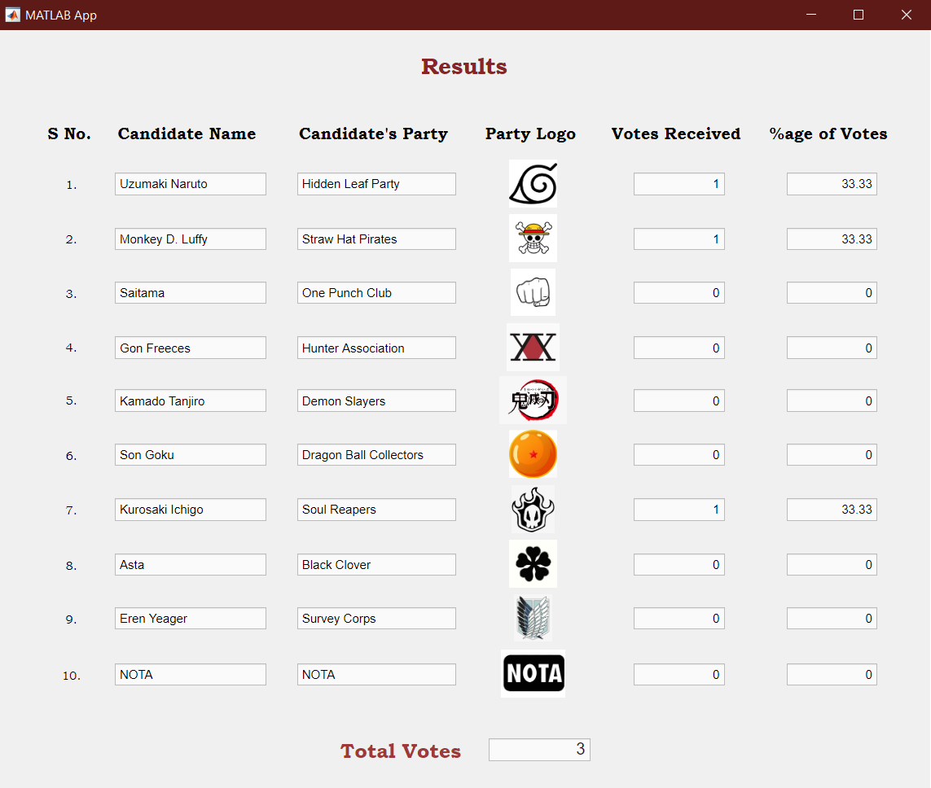
In this case, since no one has gained more than 50% of votes, none of the candidate’s credentials has become bold

Slide 12
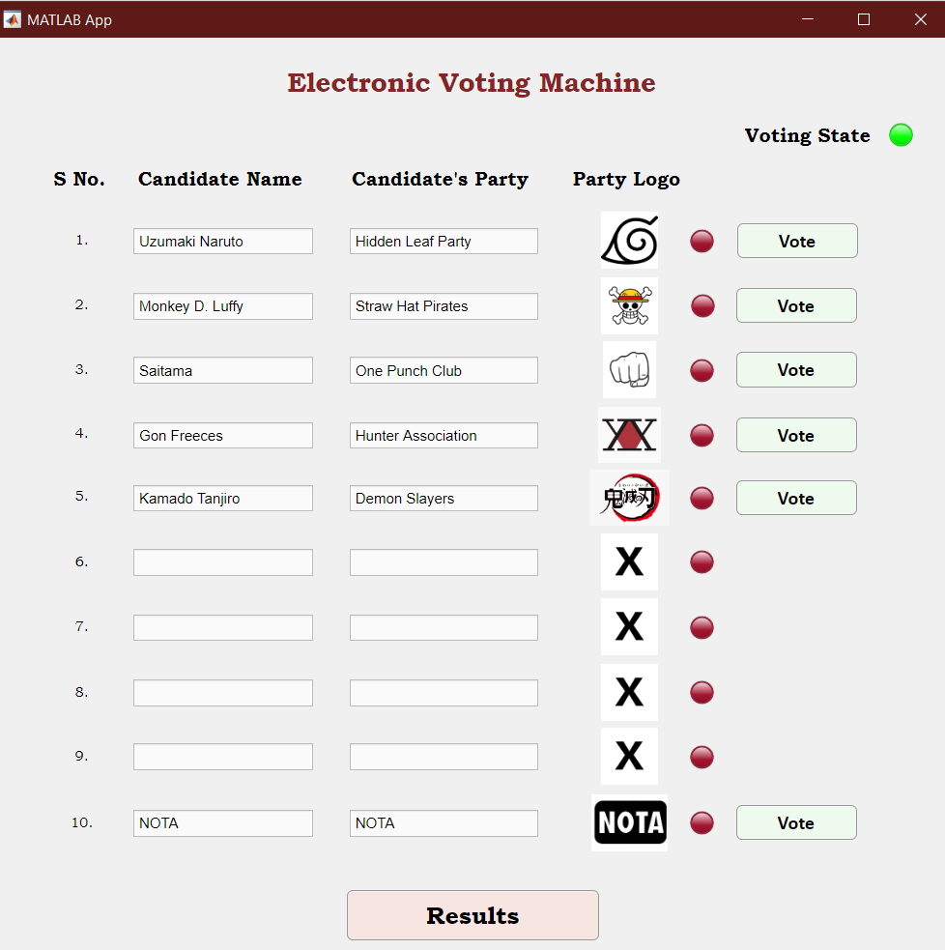
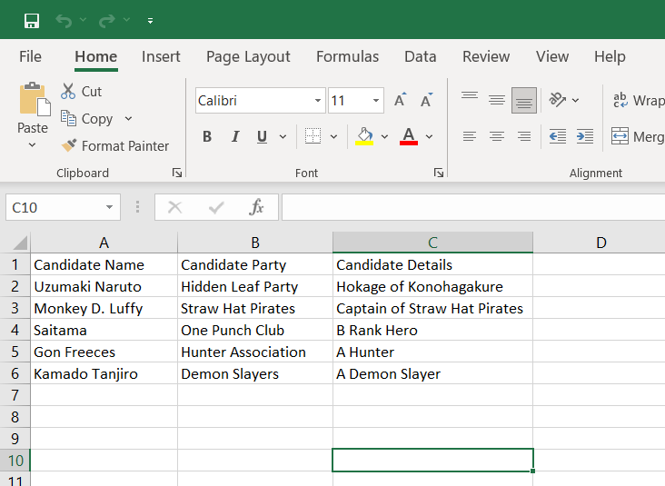
In the case of fewer than 9 Candidates in the Election file, the fields remain blank and the logo is replaced by an X mark image.
The visibility state of vote buttons in front of the fields is turned off so that vote can’t be casted to that field.

Slide 13
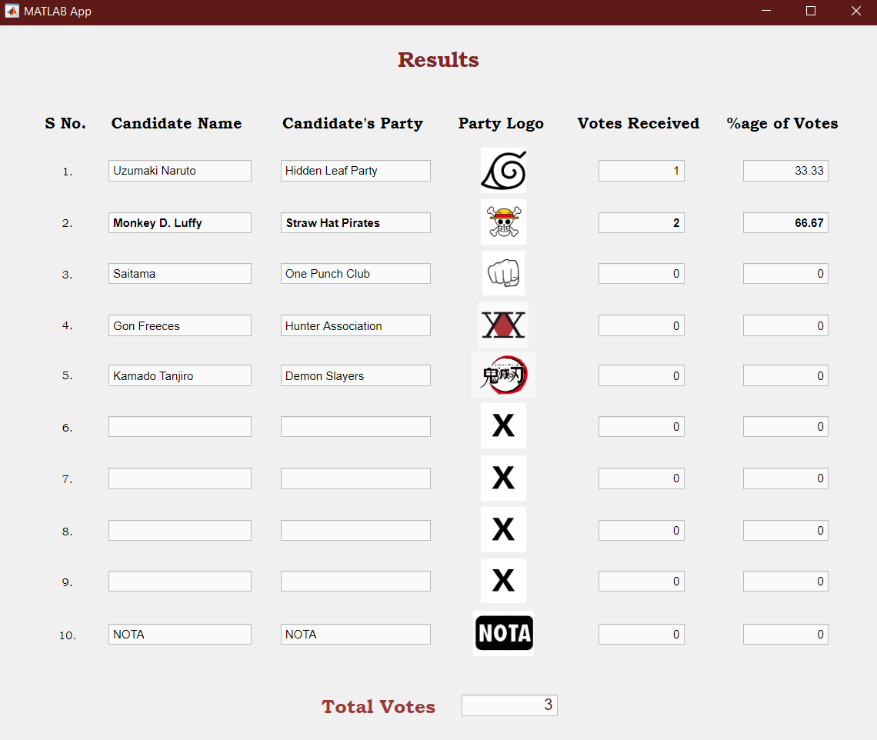
Similar changes can be seen being reflected on the results window too.

Slide 14
Analysis
With only some slight addition in the program, the maximum number of candidates can be increased, but if it exceeds a certain limit,(20-25), a series of such machines can be connected to create a Large scale voting machine. The code of it will require changes in the results page and another simple run screen which will run the required number of “VotingMachine.mlapp” programs so as to fit the requirement and can be achieved with some modifications in the code.
This machine can conduct numerous elections each time just by changing the Election.xlsx file and adding party logos which is a very good advantage of it.
Proper steps have been taken everywhere to prevent any malpractice during the voting round and can be made more secure by storing the admin passcode in a physical device or such.
If required, the results of the election can be stored in the Excel file very easily but to prevent data leak in important elections, this hasn’t been done.

